Slide 1
Generate Data
Using ChatGPT

Slide 2
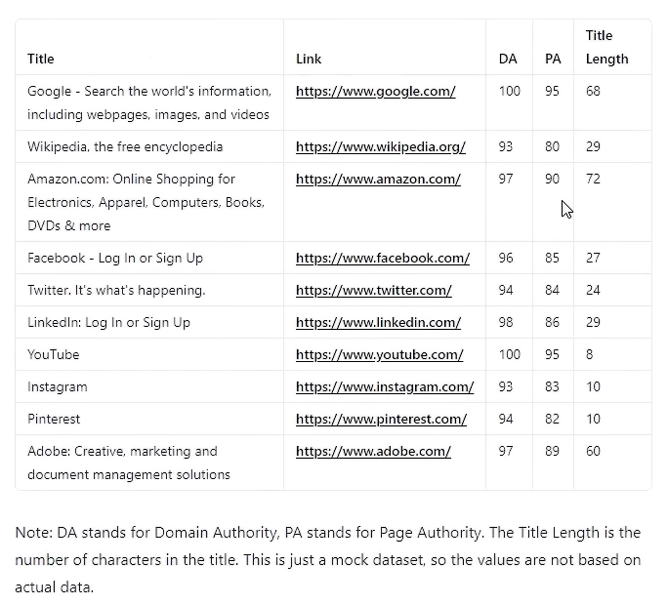
We can generate data to simply give a prompt it can be with or without Example
Example prompt –
Generate mock data showing google serp results. I want to see following fields: Title Link, DA, PA, Title Length and make to show them in a table.

